Slide 1

Introduction to HTML and CSS
HTML (Hypertext Markup Language) and CSS (Cascading Style Sheets) are the fundamental building blocks of web development, working together to create visually appealing and interactive websites.

Slide 2
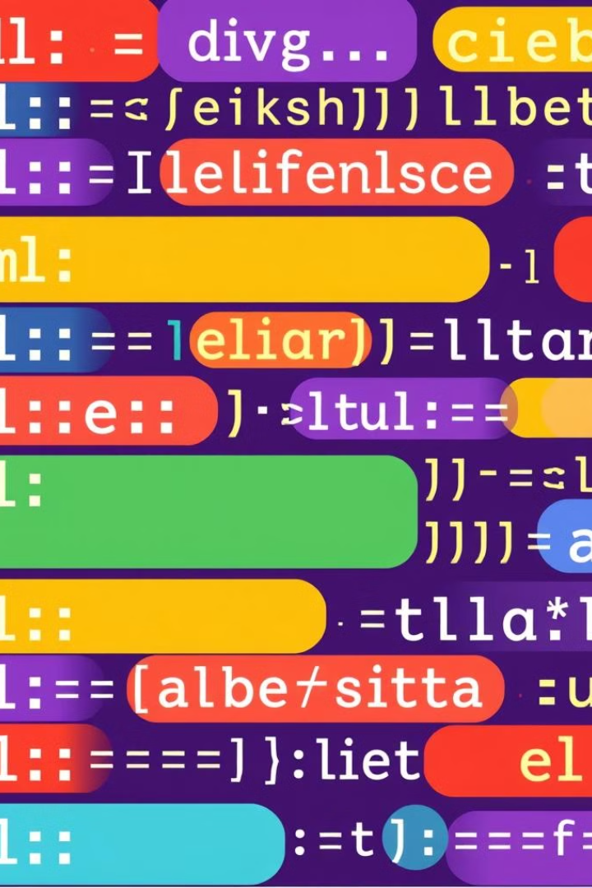
What is HTML?
1
Markup Language
2
Elements and Tags
HTML is a markup language that defines the structure and content of web pages.
HTML uses a system of elements and tags to represent headings, paragraphs, images, links, and other web page components.
3
Semantic Markup
Properly using HTML elements adds meaning and structure to web content, making it more accessible and SEO-friendly.

Slide 3
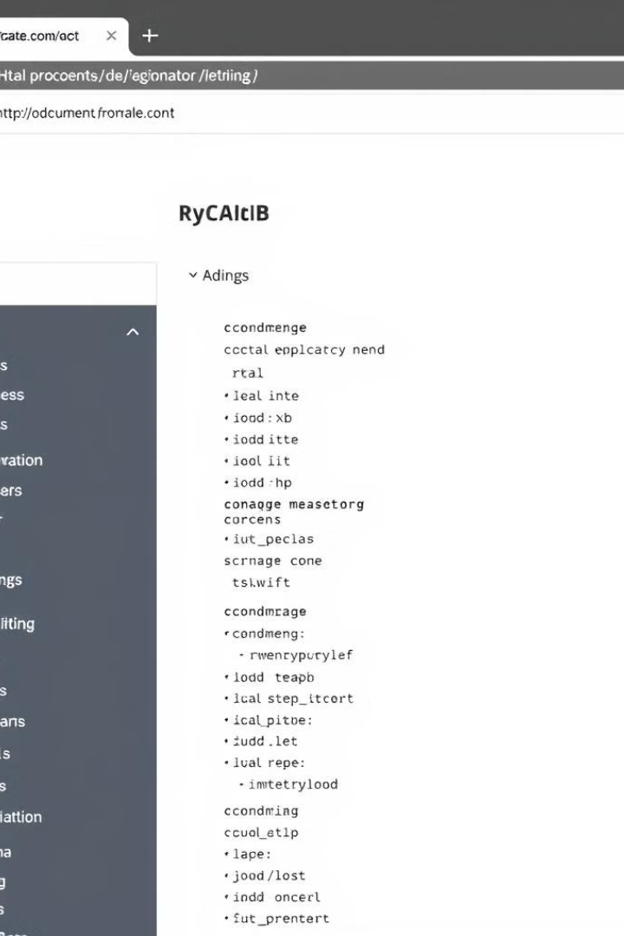
HTML Structure and Syntax
1
Document Structure
HTML documents have a standard structure, including the <html>, <head>, and <body> elements.
2
Elements and Attributes
HTML elements are defined using opening and closing tags, and can have additional attributes to provide more information.
3
Nested Elements
HTML elements can be nested within each other to create more complex web page structures.

Slide 4
What is CSS?
Presentation Layer
Separation of Concerns
Flexible Styling
CSS is the language used to style and layout the content defined by HTML, acting as the presentation layer.
Separating HTML (content) and CSS (presentation) allows for better code organization and maintainability.
CSS provides a wide range of properties and values to control the visual appearance of web pages.

Slide 5
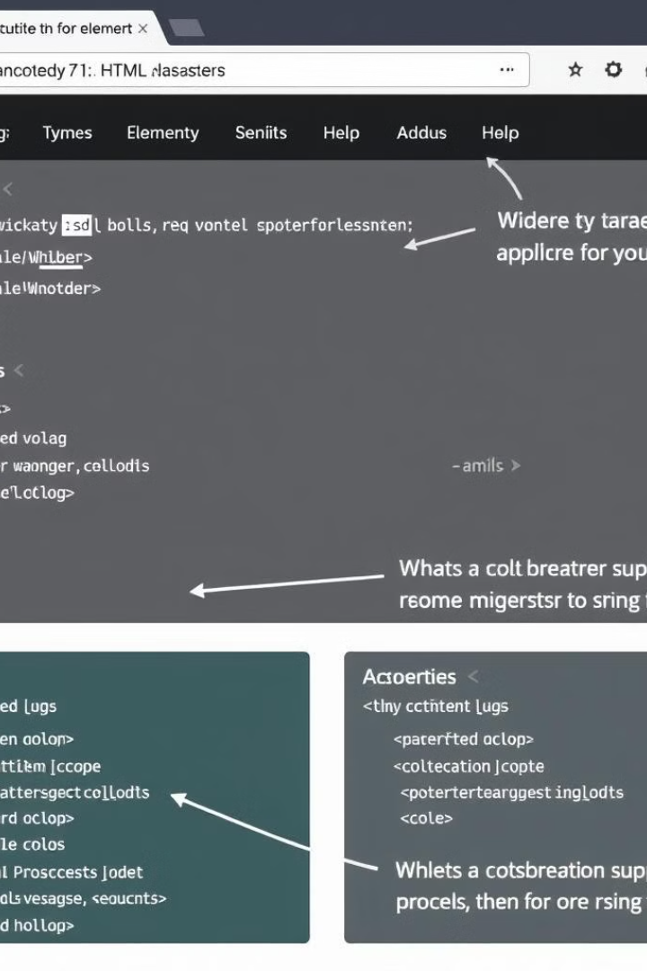
CSS Selectors and Properties
Selectors
Properties
CSS selectors are used to target and apply styles to specific HTML elements, such as tags, classes, or IDs.
CSS properties define the visual characteristics of an element, such as color, font, size, and layout.
Cascading
Inheritance
The cascading nature of CSS allows for the prioritization and overriding of styles based on specificity.
Some CSS properties can be inherited by child elements, simplifying the styling process.

Slide 6




Styling with CSS
Color
CSS allows you to apply colors to text, backgrounds, and other elements using various color models.
Typography
Comprehensive control over font styles, sizes, and families helps create visually appealing typography.
Layout
CSS layout techniques, such as flexbox and grid, enable the creation of complex and responsive designs.

Slide 7




Responsive Web Design with HTML and CSS
Flexible Layout
Fluid Images
Mobile-First Approach
CSS media queries and responsive design techniques allow web pages to adapt to various screen sizes.
Images can be made responsive by using relative units and max-width properties in CSS.
Designing for mobile devices first, then progressively enhancing for larger screens, ensures optimal user experience.

Slide 8
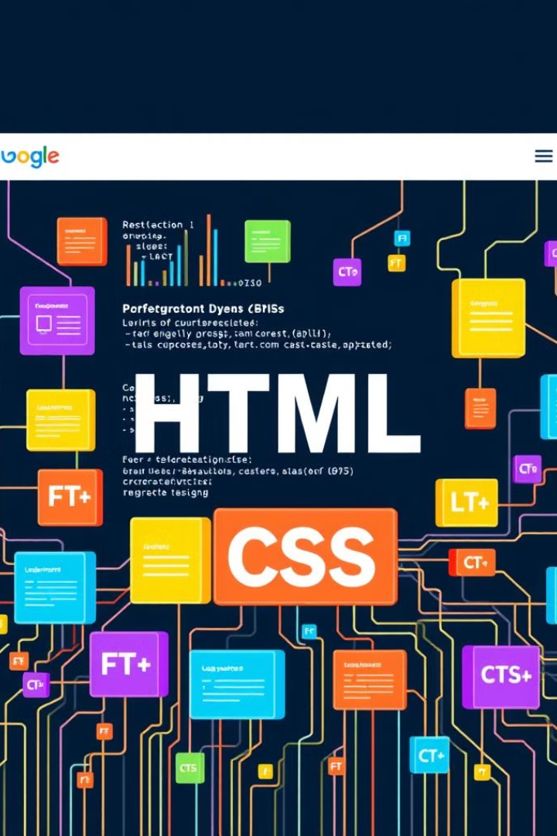
Conclusion and Q&A
In conclusion, HTML and CSS work together to create visually stunning and interactive websites. By mastering these fundamental web technologies, developers can build responsive and accessible web experiences.
MADE BY
DEVARSH PRAJAPATI (LEADER)
YASH PANCHAL
CHINTAN VARMA

